Slide 1
Real-Time Disaster Information Aggregation Software
PIP4004 Capstone Project
Review-0
Batch Number: CSE_ISR_CAP_01
Roll Number Student Name
Under the Supervision of,
Dr. Sivaramakrishnan
Professor / Associate Professor / Assistant Professor
School of Computer Science and Engineering
Presidency University
20211ISR0078 Bhavana B A
20211ISR0038 Disha R
20211ISR0021 Monika P
Name of the Program: B. Tech (Capstone Project)
Name of the HoD: Dr. Zafar Ali Khan
Name of the Program Project Coordinator: Dr. Afroz Pasha
Name of the School Project Coordinators: Dr. Sampath A K / Dr. Abdul Khadar A / Mr. Md Ziaur Rahman

Slide 2
Content
Problem Statement
Github Link
Analysis of Problem Statement
Timeline of the Project
References

Slide 3
Problem Statement Number: PSCS-389
Organization: National Disaster Response Force (NDRF)
Category: Software
Problem Description: Disaster response agencies often stuggle to gather timely and specific information about emergencies from various
sources. Social media platforms serve as a valuable repository of such data, but manually monitoring and sorting through the vast amount of
information is inefficient and resource-intensive. Description: There is a pressing need for a software solution that can efficiently aggregate and
categorize specific disaster-related data from social media, news portals, and other open sources. This software would utilize advanced
algorithms to sift through the abundance of information and classify it into different categories data would then be presented on a user- friendly
dashboard, allowing disaster response agencies to quickly access relevant information and plan their actions accordingly. Expected Solutions:
The software solutions will streamline the process of gathering and categorizing disaster-related data from various soucres, significantly
reducing the time required for response efforts. By providing real-time insights and actionable information, the software will enhance the
effectiveness of disaster response operations, ultimately saving lives.
Difficulty Level: Simple

Slide 4
Github Link
https://github.com/monikap384/Real-Time-Disaster-Information-Aggregation-Software

Slide 5
Analysis of Problem Statement
1. Identifying the Core Problem:Disaster response agencies face significant challenges in gathering timely, specific, and accurate information about ongoing emergencies. Traditional methods of obtaining data—such as field reports and official announcements—are often delayed, making rapid decision-making difficult.
2. The Role of Social Media and Open Data Sources: manually monitoring and filtering through vast amounts of data is:
Time-consuming: Agencies must sift through millions of posts.
Resource-intensive: Requires significant human effort.
3. Need for an Automated Solution: To address these challenges, a software solution is needed that can:
Automatically aggregate data from multiple sources.
Classify and filter information based on relevance and reliability.
Present insights in a user-friendly dashboard to aid decision-making.

Slide 6
Analysis of Problem Statement
Technology Stack Components:
Identify Requirements
Frontend Technologies
Backend Technologies
Database Technologies
Additional Components
Integration and Compatibility

Slide 7
Analysis of Problem Statement (contd...)
Software and Hardware Requirements:
Software Requirements:
Frontend (java script)
Backend (java script)
Database : Machine Learning
Hardware Requirements:
Storage
Network Requirements
Peripheral Devices

Slide 8
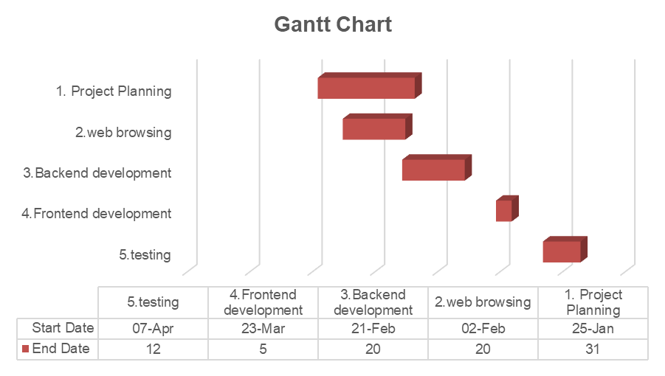
Timeline of the Project (Gantt Chart)
Task | Duration | Start Date | End Date
1. Project Planning | 1 week | 25-Jan | 31
2.web browsing | 3 weeks | 02-Feb | 20
3.Backend development | 4 weeks | 21-Feb | 20
4.Frontend development | 2 weeks | 23-Mar | 5
5.testing | 1 week | 07-Apr | 12
6.deployment | 1 week | 14-Apr | 21

Slide 9
References (IEEE Paper format)
1.M. Bostock, “D3.js – Data-Driven Documents,” D3.js Official Documentation, 2024. [Online]. Available: https://en.wikipedia.org/wiki/D3.js. [Accessed: Jan. 30, 2025].
2.Pixel Free Studio, “How to Use Node.js for Real-Time Data Processing,” Pixel Free Studio Blog, 2024. [Online]. Available: https://blog.pixelfreestudio.com/how-to-use-node-js-for-real-time-data-processing. [Accessed: Jan. 30, 2025].
3.Vega Team, “Datalib – JavaScript Data Utility Library,” Vega Project Documentation, 2024. [Online]. Available: https://vega.github.io/datalib. [Accessed: Jan. 30, 2025].
4.Webix Team, “Webix: JavaScript UI Library,” Webix Official Documentation, 2024. [Online]. Available: https://en.wikipedia.org/wiki/Webix. [Accessed: Jan. 30, 2025].
5.GeeksforGeeks, “Disaster Management Website using MERN,” GeeksforGeeks Tutorials, 2024. [Online]. Available: https://www.geeksforgeeks.org/disaster-management-website-using-mern. [Accessed: Jan. 30, 2025].

Slide 10


